Slide 1
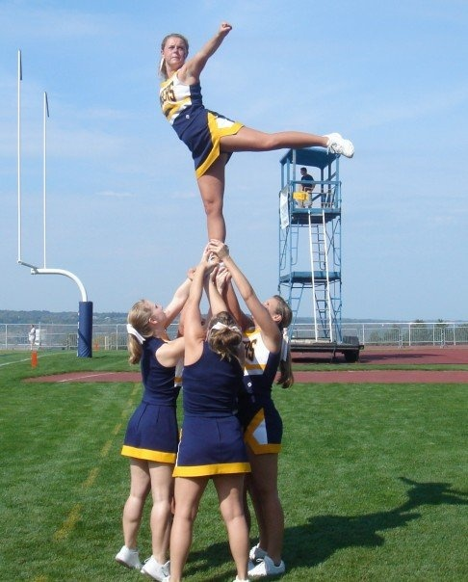
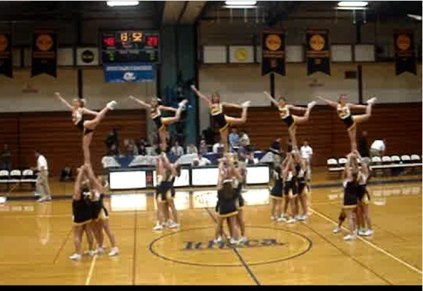
Ithaca College Cheerleading Try-outs
Friday, August 28th
Mandatory Informational Meeting - 4:00 - 5:30 pm Williams Hall - Room 317
Saturday, August 29th Tryout Practice - 10:00 am - 3:00 pm Hill Center - Gymnastics Room
Sunday, August 30^{sh} Tryouts - 10:00 am - 1:00 pm Hill Center - Gymnastics Room
Questions? Contact:
Jessica Sharkey at president@iccheer.com
For more details, visit http://www.iccheer.com
Sponsored by IC Recreational Sports

